Slide 1
IBM Capstone
Data Science
Peer-graded Assignment
Explore Where To Open A Meat Free Restaurant In Europe?

Slide 2

Background
Over the last 10 years a large family fast food restaurant chain/franchise has recognised a slow decline in its number of customers. Worryingly in the last four years the waning of its customer traffic has increased, it is true that the fast food restaurant category is experiencing a decline in its customer base. But this world-renowned franchise is declining at a faster rate. There are great concerns with in senior management that increased sales on an ever-shrinking customer base and is now on a certain path to brand disaster.

Slide 3
Bold statements that did not deliver
2013
In 2013 the new CEO at the time was quoted as saying its goal was “To be a modern and progressive burger company.”
Oct. 2016
An international news agency obtained an internal email in October 2016 which summarized a September meeting with executives and franchisees. It read, "Growing customer counts is our main challenge.”

Slide 4

As much as the company has focused on:
  Providing great tasting food
  Innovation
  Service Speed
  Focus on franchisee profitable revenue growth
  Building on customer loyalty
  There is a requirement from senior management to re-engineer the brand or invent a silent sister brand, if it is to have a chance of survival.
  Without franchisees upholding the brand, shareholders will wind up with nothing to hold.

Slide 5
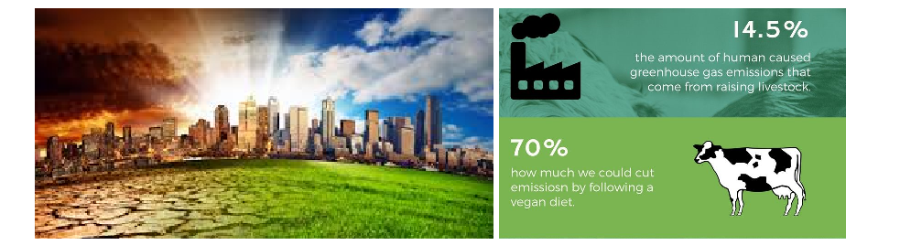
Description of the problem
The customers they are losing tend to be more healthy eating conscious and ultra-concerned by the impact eating meat products has on the climate. Fact 1 in 10 people on the planet are now vegetarian, a statistic that climbing.
The mass production of meat is the single biggest cause of land clearing around the world, if not directly for the animals themselves then indirectly for the monocultures such as corn or soy that feed them.
Environmental degradation also goes together with the global pandemic of chronic diseases including obesity, diabetes, cancer and heart disease.
Having listened to the VOC (voice of the customer) it has become apparent that many of its custom base have aged, and with age comes life experience, education and health concerns. Many now have had family’s and will want to pass on everything that they have learned and experienced on to their children. This does not bode well for its future generation customer. The challenge is to create a different opening for those customers that are falling by the wayside.
It has been proposed to consider creating a new brand for a new era, a non-meat family fast food sustainable restaurant brand, with the core ethos on the environment.

Slide 6
Specification Statement
There is a need to find a prime location to open a meat free fast food family, healthy eating restaurant in a city within Europe, and the chosen city needs to be powered by 75% or more renewable energy.

Slide 7
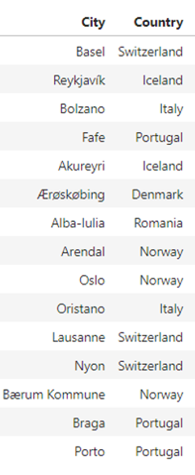
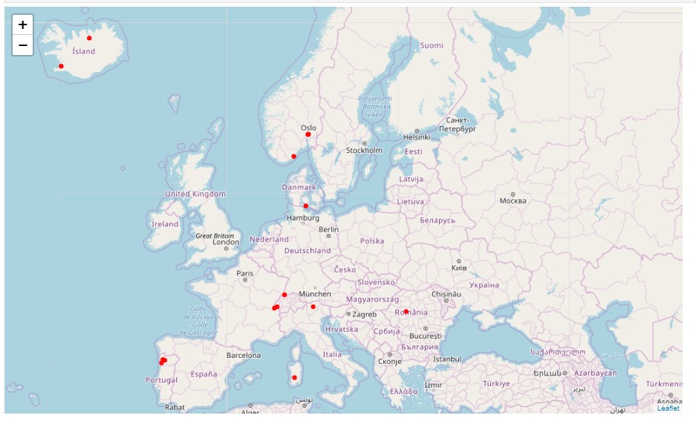
Cities in Europe Powered Using 75% or More Renewable Energy Sources

Slide 8
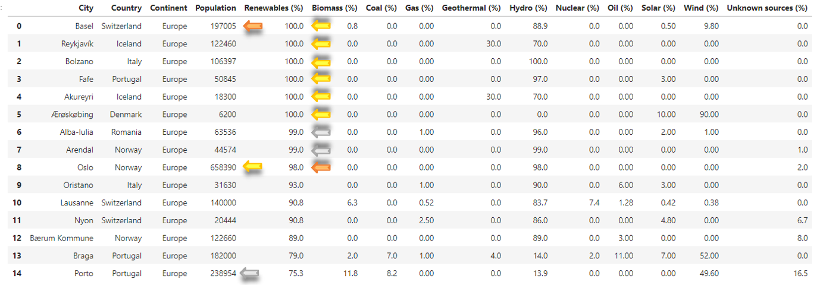
The statistics below show:
six cities in Europe whose energy power sources are 100% sustainable by means of renewable energy
one city whose population clearly stands out from the rest (Oslo, population of 658,390)
two cities fall into the top three with regards to the highest percentage of renewable energy used to power the city and having one of the larger populations

Slide 9
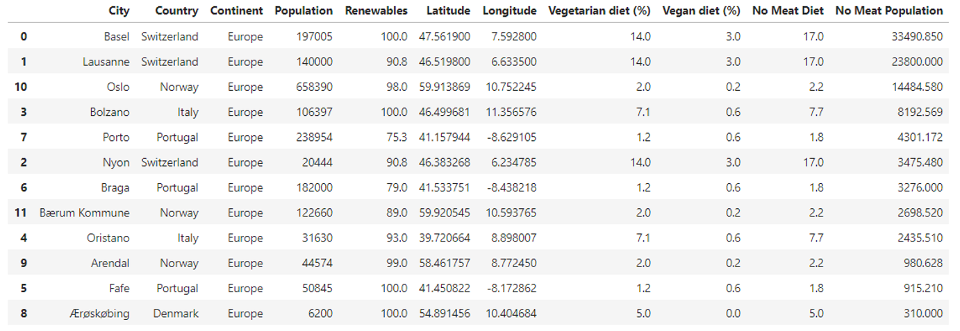
Compare European countries with cities powered by renewable energy (equal or greater 75%) to those with countries with A high number of non meat eaters

Slide 10
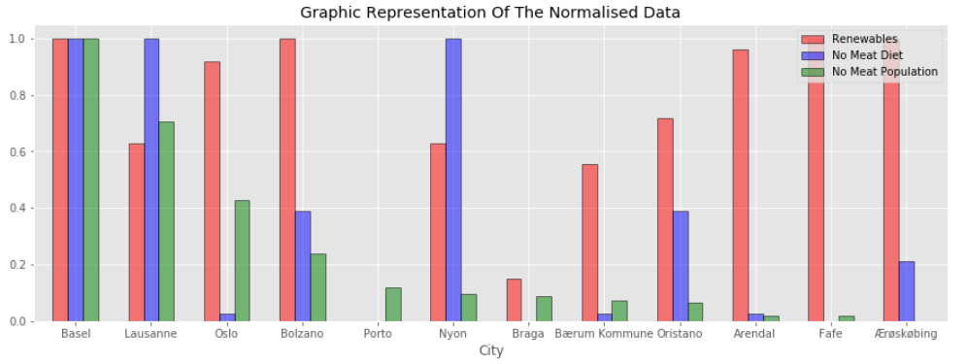
- highest percentage of renewable energy used to power the city of choice (red)
- highest percentage of a countries population that are on a meat free diet (blue)
- highest estimated meat free diet population (green)

Slide 11
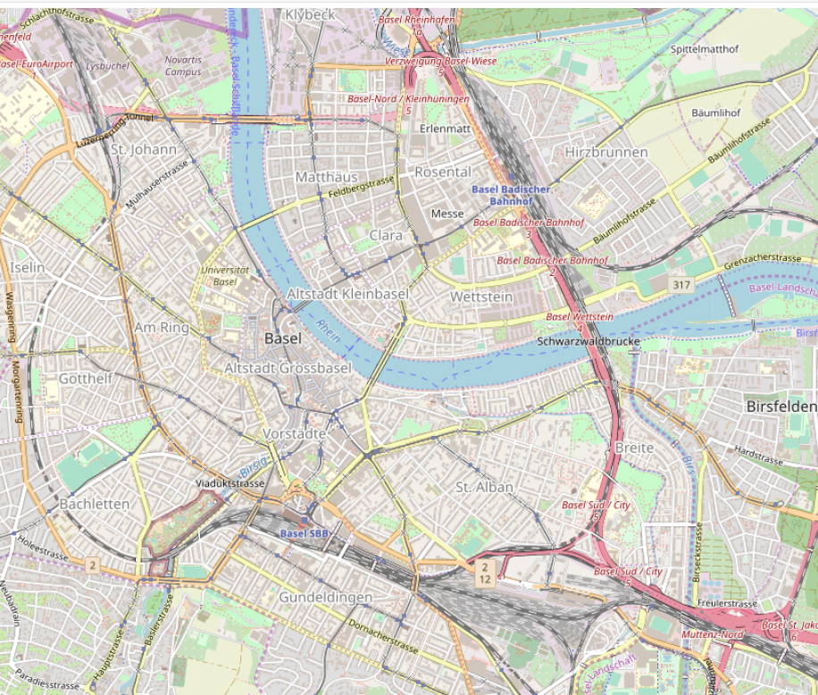
Basel is the city of choice a city powered 100% by renewable energy
17% of the population are on a meat free diet highest number of non-meat eaters 33490 people

Slide 12
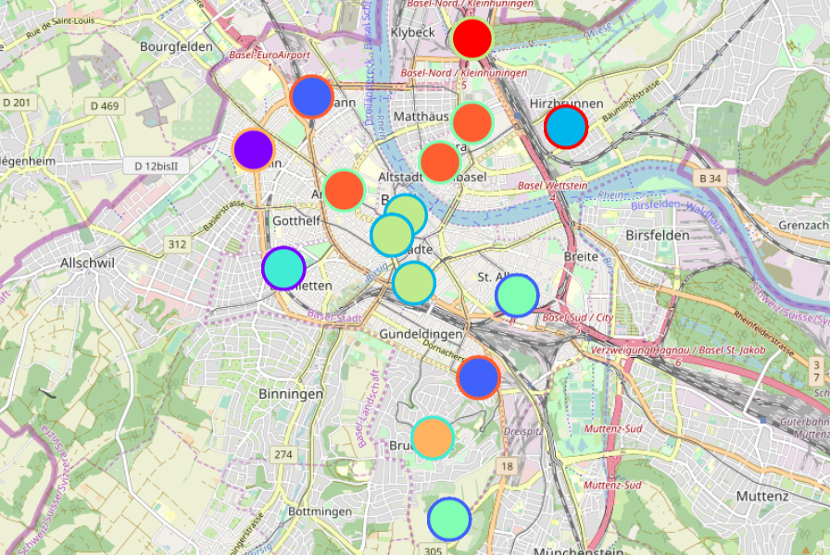


Exploring Basel (Using Foursquare and Clustering Techniques)
Two Clusters stand out in regards to the area where most of the restaurants are located:
Hotel 1/ 0.17 Middle Eastern Rest/ 0.10 Tram Station/ 0.10 Indian Restaurant/ 0.07 Café 0.07 Hotel 2/ 0.20 Thai Restaurant/ 0.10 Supermarket/0.07 Bar 1/ 0.07 Steakhouse/0.07 Restaurant/0.17 Bar 2/ 0.10 Bakery/0.07 Hotel/0.07 Wine Bar/0.03
Swiss Restaurant/0.13 Plaza/0.10 Café/0.10 French Restaurant/0.07 Chocolate Shop/0.07 Bar/0.13 Hotel/0.10 Pizza Place/0.07

Slide 13
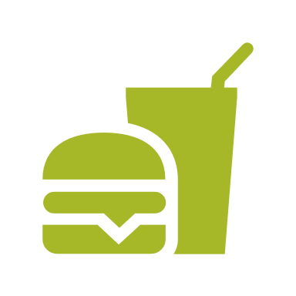
Certain fast food restaurants succeed simply because their locations are so accessible, like restaurants landmarks, the most famous landmarks of Basel are mostly found in cluster 0.
There is plenty of foot traffic in urbanized areas, and restaurants only need to attract customers from the street into their business. The urbanized areas of Basel have been incorporated in our analysis, clusters 0 to 8 as we move close to the city center the pedestrian areas become denser with foot traffic.
Most successful restaurants other than the truly elite are easy to find, and you will find them in city centers or unique locations throughout the world. The city center of Basel can be found situated in clusters labelled 0 and 7.

Slide 14
Conclusion
Our recommendations are to open fast food meat free restaurant in the surroundings of Clusters 0 or 7.
The streets that stretch across these clusters are populated with well-established cafes/bars and restaurants, which the city dwellers and workers will be familiar with.
The location of these clusters are central point of the shops, hotels and is equally distance for those living in the surrounding suburbs.
I would suggest to try and finding a location close to one of Basel’s known landmarks to catch the passing tourist trade and near one of the tram stations.
This should prove to help guarantee customers and enhance the success of the restaurant.

Slide 15
This presentation has been written to demonstrate how to apply and analyse the tools, theories and skills learnt whilst completing modules 1-8 in this IBM Data Science Specialization, using data-science.

